Slide 1
Data Disclosure
August, 2025

Slide 2
Instrument Back Test: Equity and Equity Derivatives, Commodity Derivatives
Updated at 8 July 2025
Equity and Equity Derivatives – HP 2
Instrument TYPE | Number of Instruments | Long Coverage Level | Short Coverage Level | Full Coverage Level
CASH | 7 131 | 99.91% | 99.82% | 99.86%
BOND | 262 | 99.88% | 99.69% | 99.78%
OPTIONS | 35 359 | 99.82% | 99.80% | 99.81%
FUTURES | 50 | 99.94% | 99.80% | 99.87%
SSDF | 54 | 99.56% | 99.61% | 99.58%
TOTAL | 42 856 | 99.85% | 99.81% | 99.83%
Commodity Derivatives – HP 2
Instrument TYPE | Number of Instruments | Long Coverage Level | Short Coverage Level | Full Coverage Level
OPTIONS | 1 205 | 99.38% | 100.00% | 99.69%
FUTURES | 62 | 99.88% | 99.91% | 99.90%
TOTAL | 1 267 | 99.40% | 100.00% | 99.70%
Margin Sensitivity Test
Very low sensitivity to changes in parameters:​ Small changes in input parameters (i.e. Confidence Levels) generate small changes in output value (i.e. margins amounts)
Initial Margin at instrument level can be provided upon request to ENXC Risk Dept.

Slide 3
Instrument Back Test: Fixed Income
Updated at 8 July 2025
Instrument Back Test Confidence Level
GOVERNMENT BOND ASSET CLASS
Instrument TYPE | Coverage Level | Number of Instruments | Instruments between 99.7% and 99.5% | Instruments strictly below 99.5%
ITALY | 100.00% | 218 | 0 | 0
SPAIN | 100.00% | 79 | 0 | 0
PORTUGAL | 99.92% | 42 | 0 | 3
IRELAND | 99.99% | 36 | 0 | 0
TOTAL | 99.99% | 375 | 0 | 3
CORPORATE BOND ASSET CLASS
Class | Time to Expiry | Coverage level | N.of instruments | Instruments between 99.7% and 99.5% | Instruments strictly below 99.5%
31 | (0-3] years | 99.75% | 1 837 | 28 | 164
32 | [3-5] years | 99.77% | 465 | 7 | 43
33 | [5-7] years | 99.76% | 308 | 2 | 24
34 | [7-10] years | 99.91% | 311 | 6 | 10
35 | >= 10 years | 99.98% | 627 | 1 | 4
TOTAL |  | 99.81% | 3 548 | 44 | 245
Weighted Average Confidence Level Corporate and Government Bond
99.99%
Margin Sensitivity Test
Very low sensitivity to changes in parameters:​ Small changes in input parameters (i.e. Confidence Levels) generate small changes in output value (i.e. margins amounts)

Slide 4
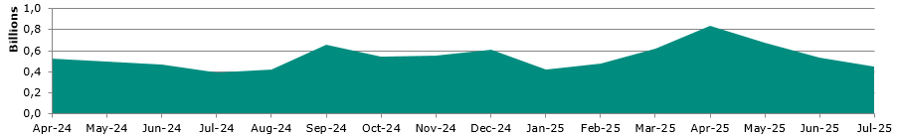
Intraday margins stats
Updated at 31 July 2025
Intraday Margins Amount (Daily Average)
Period | Days of Requests | Number of Requests | Amount Requested | Daily Average | Average IDM
Apr-24 | 21 | 1 233 | 11 036 347 617.18 | 525 540 362.72 | 8 950 809.10
May-24 | 22 | 1 263 | 10 867 711 817.99 | 493 986 900.82 | 8 604 680.77
Jun-24 | 20 | 1 255 | 9 399 727 261.07 | 469 986 363.05 | 7 489 822.52
Jul-24 | 23 | 1 387 | 9 154 354 978.05 | 398 015 433.83 | 6 600 111.74
Aug-24 | 22 | 1 206 | 9 257 836 780.70 | 420 810 762.76 | 7 676 481.58
Sep-24 | 21 | 1 177 | 13 769 778 727.73 | 655 703 748.94 | 11 699 047.35
Oct-24 | 22 | 1 335 | 11 970 620 726.46 | 544 119 123.93 | 8 966 757.10
Nov-24 | 21 | 1 251 | 11 666 890 831.36 | 555 566 230.06 | 9 326 051.82
Dec-24 | 20 | 1 157 | 12 243 047 352.83 | 612 152 367.64 | 10 581 717.68
Jan-25 | 22 | 1 321 | 9 338 083 850.60 | 424 458 356.85 | 7 068 950.68
Feb-25 | 20 | 1 070 | 9 605 642 823.27 | 480 282 141.16 | 8 977 236.28
Mar-25 | 21 | 1 422 | 13 081 714 858.99 | 622 938 802.81 | 9 199 518.18
Apr-25 | 20 | 1 313 | 16 757 730 229.12 | 837 886 511.46 | 12 762 932.39
May-25 | 21 | 1 281 | 14 241 280 084.99 | 678 156 195.52 | 11 117 314.66
Jun-25 | 21 | 1 156 | 11 163 028 631.74 | 531 572 791.99 | 9 656 599.16
Jul-25 | 23 | 645 | 10 454 962 500.58 | 454 563 586.98 | 16 209 244.19

Slide 5
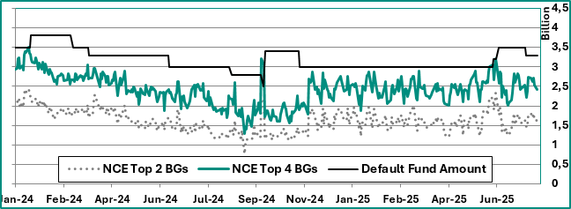
Default Funds - Stress Test Results 1/2
Updated at 31 July 2025
Fixed Income: Historical trend
Last Stress Test Executed (NCE Cover 4 - €/mln)
Yield Decrease | € 187
Yield Increase | € 1 671
Yield Flattening (5YZ: +169 bps. 10YZ: +132 bps) | € 1 672
Yield Steepening (3YZ: +100 bps. 10YZ: +198 bps) | € 2 414

Slide 6
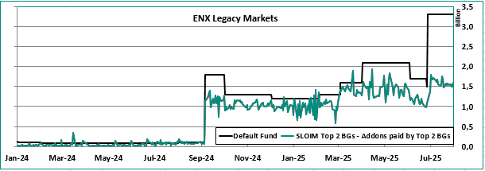
Default Funds - Stress Test Results 2/2
Updated at 31 July 2025
Eq./Eq.Der. & Comm.Der.: Historical trend
* For the month of July, the total Default Fund (DF) is calculated as the sum of the DF BITA and DF LEGACY (Cover 2 + Cover 2).Starting from August 1st, the DF has been aligned with the SLOIM methodology (single Cover 2), resulting in a corresponding reduction in the overall amount.
Last Stress Test Executed – ENX Legacy (SLOIM Cover 2 - €/mln)
Eq. Extra Stress D. Vol./Com. P. Incr. D. Vol. | € 1 935
Eq. Extra Stress D. Vol./Com. P. Decr. D. Vol. | € 1 920
Eq. P. Decr. D. Vol./Com. P. Incr. D. Vol. | € 1 911
Eq. P. Decr. D. Vol./Com. P. Decr. D. Vol. | € 1 896
Eq. P. Decr. H. Vol./Com. P. Incr. H. Vol. | € 1 735
Eq. P. Decr. H. Vol./Com. P. Decr. H. Vol. | € 1 720
Eq. P. Incr. D. Vol./Com. P. Decr.D. Vol. | € 1 277
Eq. P. Incr. D. Vol./Com. P. Incr. D. Vol. | € 1 277
Eq. P. Incr. H. Vol./Com. P. Decr. H. Vol. | € 1 276
Eq. P. Incr. H. Vol./Com. P. Incr. H. Vol. | € 1 276
Eq. Real life D. Vol./Com. Real life D. Vol. | € 1 091
Eq. Real life H. Vol./Com. Real life H. Vol. | € 915
ENXC participants who wish to know whether they fall under SLOIM Cover 2 may gather this information upon request to ENXC Risk Dept.
Stress Test Reports are available upon request to ENXC Risk Dept.

Slide 7
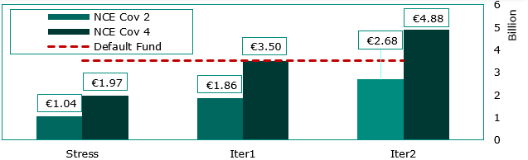
Reverse Stress Test
Updated at 20 June 2025
Fixed Income
Scenario | Iteration | Extreme Var. Mult. | BTP 10y Var.
Increase | Stress Test | 1 | 132
Increase | Iteration 1 | 2 | 264
Increase | Iteration 2 | 3 | 396
DF (€ mln) | 3 500
Equity & Equity Derivatives
Borsa Italiana
Euronext Legacy
Scenario | Extreme Var. Mult. | FTSE MIB Var. | Extreme Var. Mult. | Average Stress Var.
Upside Price Variation, Double-Volatility | 1.2 | 36.86% | 1.75 | 70.65%
Upside Price Variation, Half-Volatility | 1.2 | 36.86% | 1.75 | 70.65%
Downside Price Variation, Double-Volatility | 1.6 | -48.00% | 1.5 | -51.59%
Downside Price Variation, Half-Volatility | 1.6 | -48.00% | 1.75 | -56.93%
Extra-Stress, Double-Volatility | 1.6 | -48.00% | 1.5 | -51.59%
Real Life Price Change, Double-Volatility | 1.8 | -44.83% | 2 | -19.54%
Real Life Price Change, Half-Volatility | 1.8 | -44.83% | 2 | -19.54%
DF (€ mln) | 2 100 | 1 600
No evidence of any inappropriateness of ENXC models used for stress testing

Slide 8
Reverse Stress Test
Updated at 20 June 2025
Equity & Equity Derivatives – Scenario Breakdown
BITA
LEGACY
No evidence of any inappropriateness of ENXC models used for stress testing

