Slide 1
Using the capital markets to grow
Marianne Musaeus Vazquez
Tarjei Mellin-Olsen
Lisa Karlsen
IPOready 31 May 2022

Slide 2
Table of contents
Follow on equity raisings
High yield bonds

Slide 3
How to raise equity capital as a listed company
Rights issue
Private Placement
Equal treatment of all shareholders
All shareholders receive rights to subscribe pro rata
Most rights issues are fully underwritten
Tradable rights
Potential dilution for shareholders not participating
Prospectus
Longer process of typically 2-3 months
Expensive (direct costs, time and resources)
Typical discount to TERP range: 20-40%
Typically used for larger relative equity raisings, often in more distressed situations
Deviation from shareholders’ pre-emptive rights
Directed towards both new and current investors
Each investor must subscribe for min EUR 100,000
No prospectus requirement (certain limitations*)
Short process of 1-3 weeks – timing flexibility
Authorization of share capital increase (typically 10-20%) or EGM with 2/3 majority
Offering via over night book build after market close
Typical discount to market price 2-10%
Most common structure for raising equity capital
Followed by repair issue for fair treatment if needed
*No prospectus requirement (given min EUR 100k subscriptions) for companies on unregulated market. No prospectus requirement (given min EUR 100k subscriptions) for companies on regulated market if issue is <20% (rolling 12 months)

Slide 4
The market is «always open» for quality companies
However, market sentiment heavily influences risk appetite and pricing
NOK volume ECM transactions - OSE/Euronext 2017-2022ytd
# ECM transactions - OSE/Euronext 2017-2022ytd

Slide 5
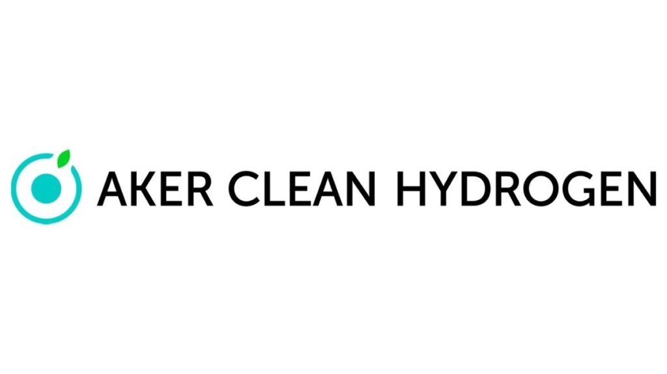
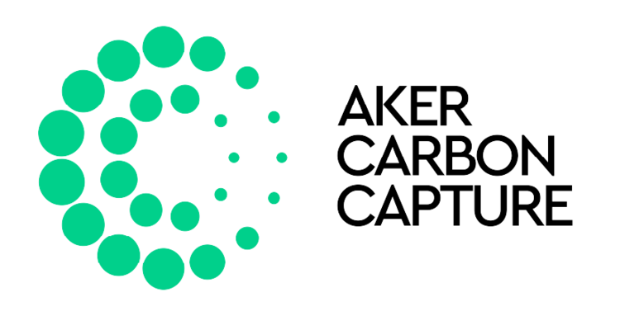
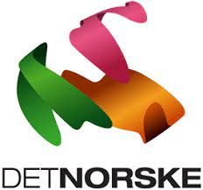
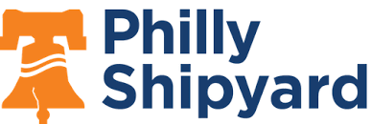
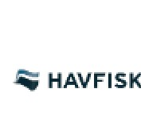
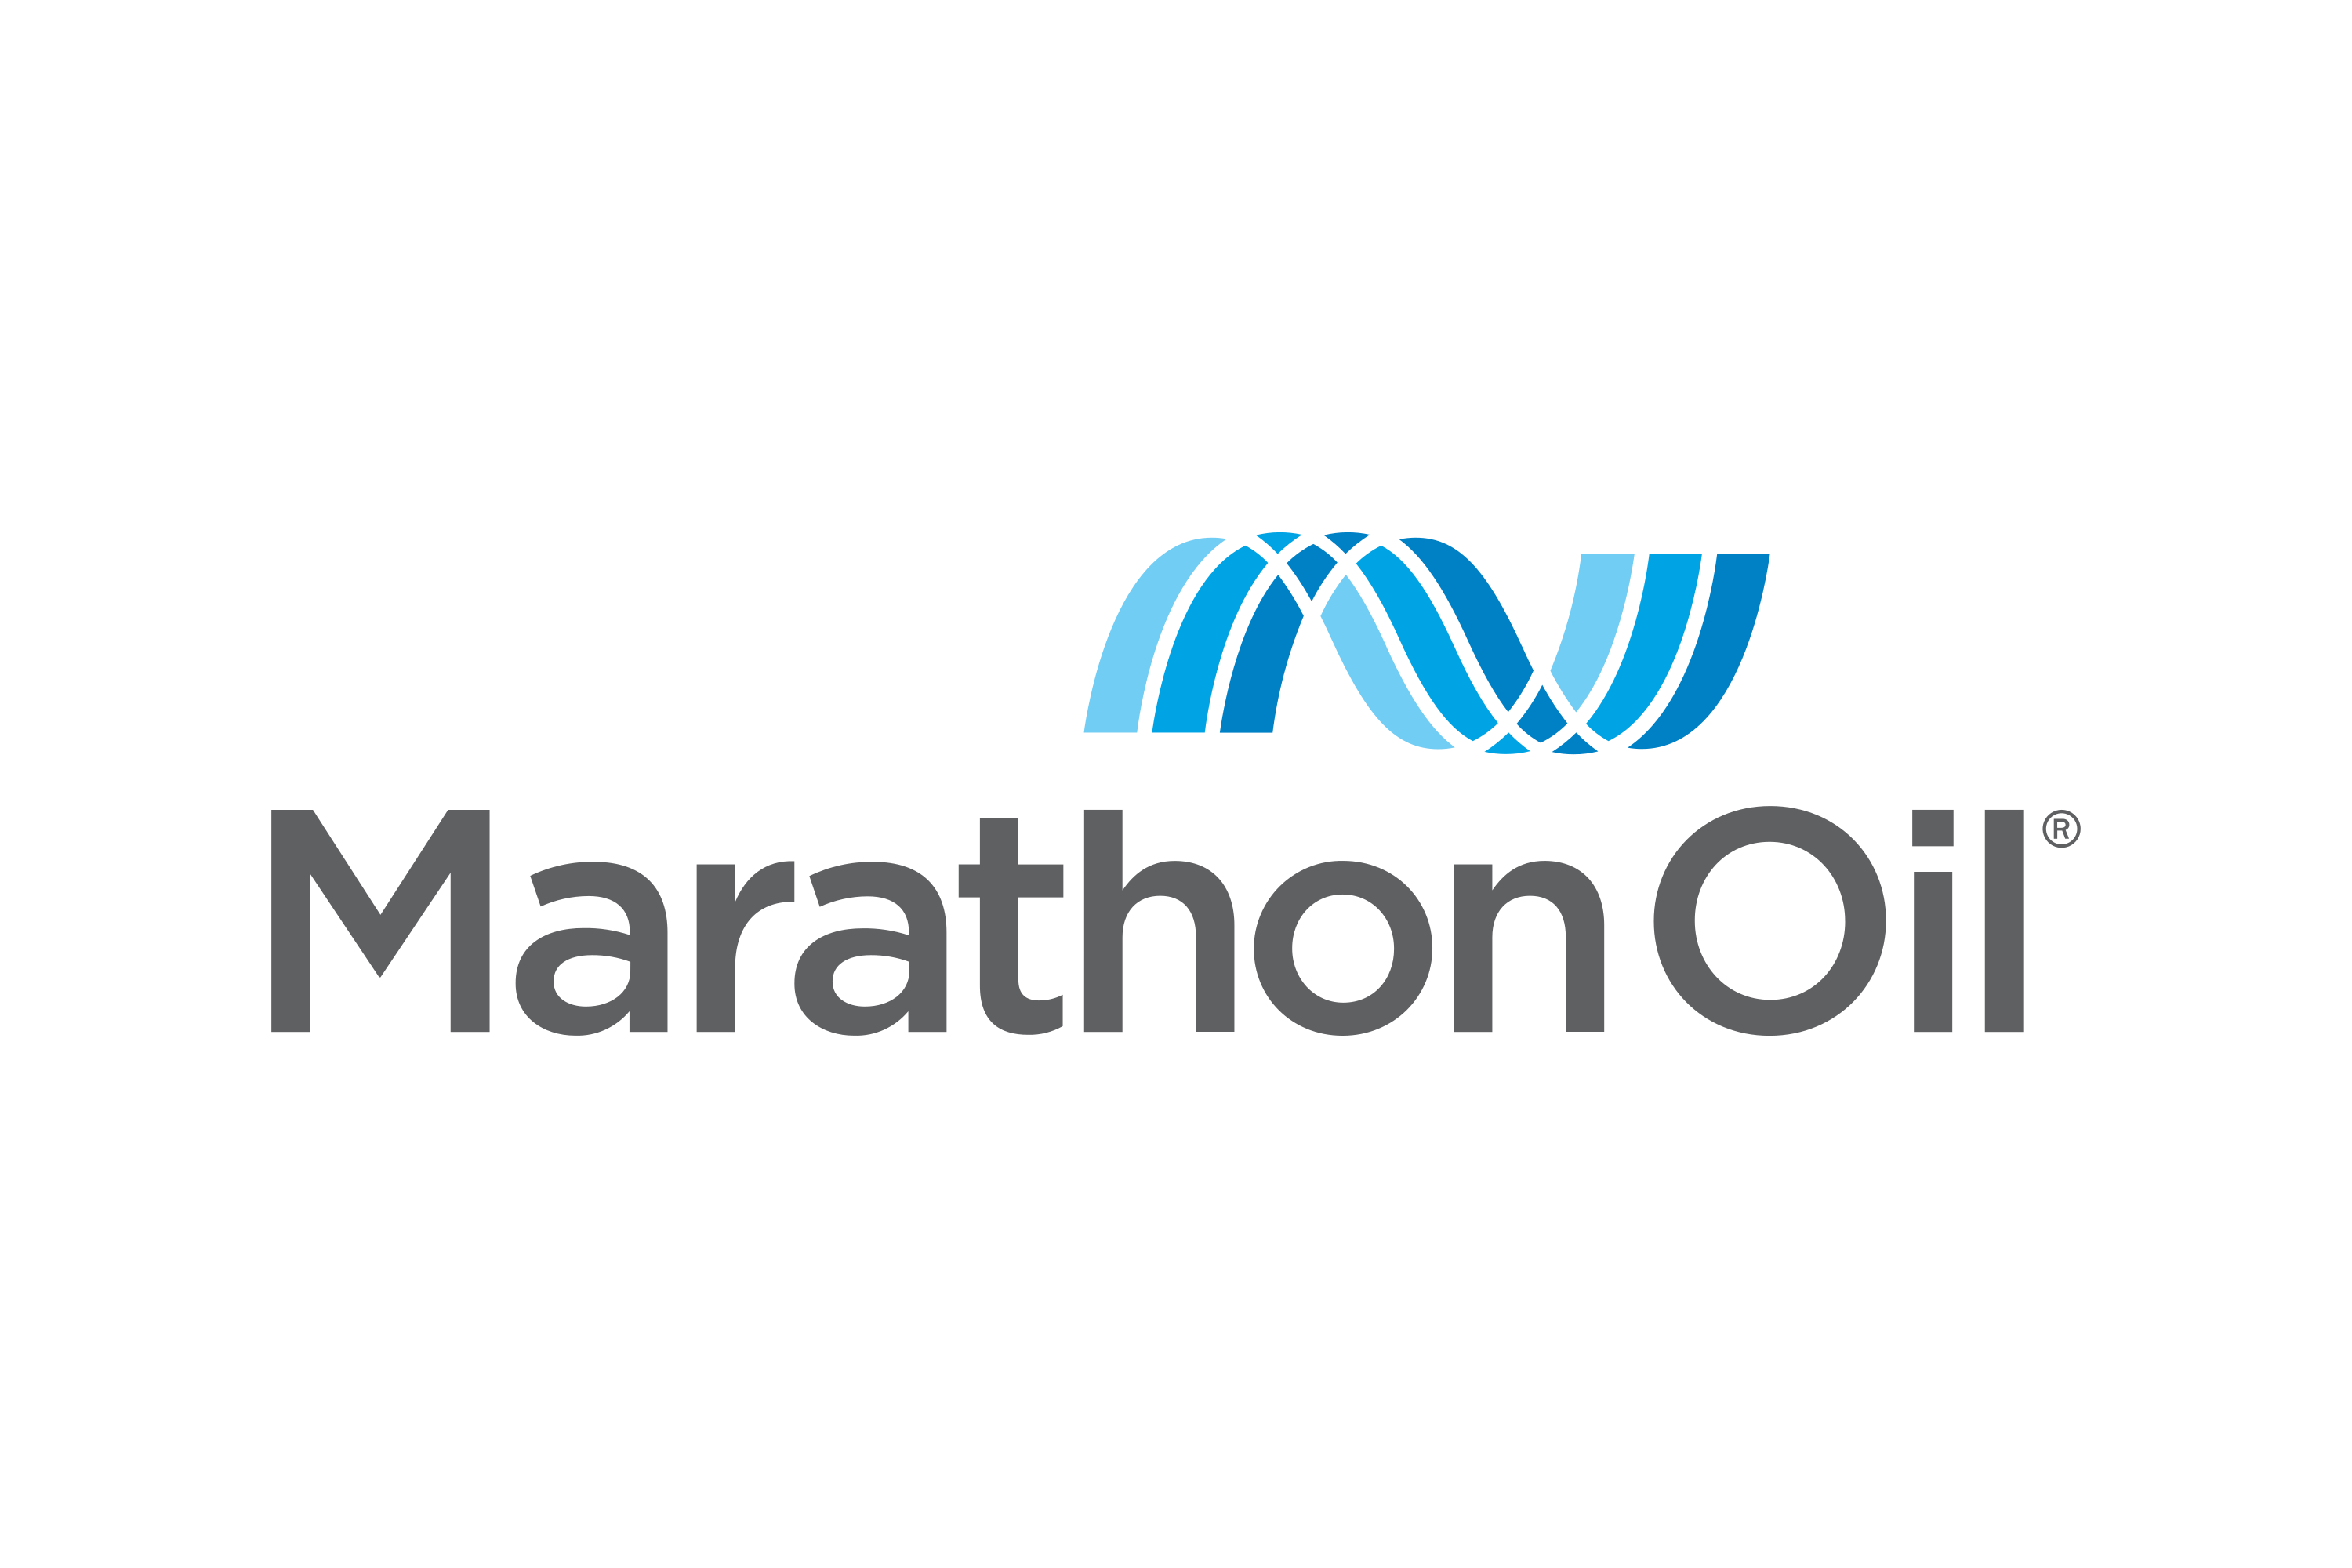
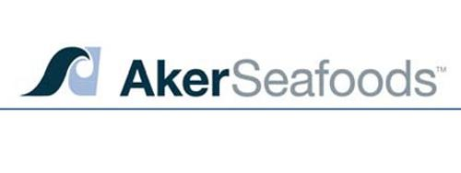
Aker’s strategic use of capital markets
Accretive transactions when the capital markets are open
Year | 2013 | 2014 | 2015 | 2016 | 2017 | 2018 | 2019 | 2020 | 2021 | 2022
IPO | IPO of Ocean Yield |  |  |  |  |  |  | Aker Biomarine: Private placement and listing | Aker Horizons: Private placement and listing. Aker Clean Hydrogen. Private placement and listing. Aker Offshore Wind: Private placement and listing.
Buy | Aker purchase of shares in AKSO |  | Aker share buyback program | Aker share buyback program |  | Aker share buyback program | Purchased minority stake in REC Silicon (22.95%) |  | Aker BP acquires Lundin Energy's O&G business | Aker purchase of shares in AKSO
Capital raise | Aker BioMarine completed refinancing agreement. Aker issued NOK 2bn and SEK 1.5bn in bonds |  | Aker NOK 1bn bond issue | Solstad Offshore raised NOK250 in private placement. Restructuring plan for Farstad Shipping |  | NOK 1.5bn bond issue |  |  | Aker private placement (NOK 4.15bn) and convertible bond issue (NOK 1.5bn)
 | Aker sold shares for NOK 905m in Ocean Yield |  |  | Havfisk and Norway Seafood sold to Lerøy Seafood |  |  |  | Accel buys a minority stake in Cognite | TCV buys a minority stake in Cognite. Aker sells Ocean Yield. Aker block sale in Aker BP | Aker Horizons sell minority stake in REC Silicon
M&A | Aker Seafoods merged with Aker BioMarine. |  |  | DNO merged with BP Norway to create Aker BP | Aker BP acquires Hess Norge |  |  |  | Aker Horizons acquires MRP | Aker Horizons acquires ACH & AOW
Share price | 222 | 165 | 164 | 323 | 403 | 462 | 544 | 560 | 825 | 866
+23% p.a.
Source: Company, Newsweb

Slide 6
The value of shareholders supporting the equity issue
Polight – NOK 125m at 22.5% discount
Quantafuel – NOK 400m at 10.7% discount
Shareholders prior to equity issue; no big 5 supported
Shareholders prior to equity issue; Kirkbi subscribed for NOK 100m
Name | Shares | Stake
Investinor Direkte AS | 1 779 858 | 19.50 %
Stiftelsen Industrifonden | 1 048 825 | 11.49 %
ABN AMRO Global Custody Services N | 390 101 | 4.27 %
Nordnet Bank AB | 382 700 | 4.19 %
Nordnet Livsforsikring AS | 344 646 | 3.78 %
Sum largest shareholders | 3 946 130 | 43 %
Total | 9 128 200 | 100 %
Name | Shares | Stake
BASF Antwerpen N.V. | 15 769 561 | 10.58 %
Danske Bank A/S (Kirkbi Invest A/S) | 14 133 208 | 9.48 %
Clearstream Banking S.A. | 11 645 768 | 7.82 %
Nordnet Bank AB | 9 936 047 | 6.67 %
JPMorgan Chase Bank, N.A., London | 6 652 719 | 4.46 %
Sum largest shareholders | 58 137 303 | 39 %
Total | 149 015 180 | 100 %
Private placement
Private placement
Priced at NOK 110 per share (equiv. NOK 22 per share after recent 1:5 split). This corresponded to a 22.5% discount to last close before announcement
Priced at NOK 25 per share. This corresponded to a 10.7% discount to last close before announcement

Slide 7
How to be best positioned to secure future funding
At IPO
Raise capital at IPO to fund the company for min. 18 months and/or beyond next large valuation milestone trigger
Secure right cornerstone/anchor investors rather than max price
Realistic equity story and transparent communication
Continuous
«Raise equity capital when it is there, not when you need it»
Always raise/maintain a buffer and start raising new capital earlier rather than later
Work strategically and long term towards new investors as well as current shareholders
Always be prepared with a <20% yearly board authorisation from the AGM to raise capital
Build credibility and investor confidence through corporate governance
Know your optimal capital structure and alternative funding options to increase flexibility

Slide 8
Table of contents
Follow on equity raisings
High yield bonds

